Slide 1
ECO346 · Assignment 1 · Fall 2026
Who earns what in urban Sindh?
PSLM 2019–20 · persons aged 15–64 with positive annual earnings · weighted by hhweight
FA24-BEDS-035 · Variant 3 = Sindh, urban (35 = 4 × 8 + 3)
2,644
Rs 264,000
5.80×
earners in the sample
weighted median annual earnings
P90 / P10 (Rs 696,000 ÷ Rs 120,000)
Notes:
OPENING (about 1 min). Introduce yourself and variant. Variant: last two digits 35, 35 = 4x8+3, so variant 3 = Sindh urban. Sample: persons 15-64 with earn_annual > 0, hhweight-weighted. Three headline numbers.

Slide 2
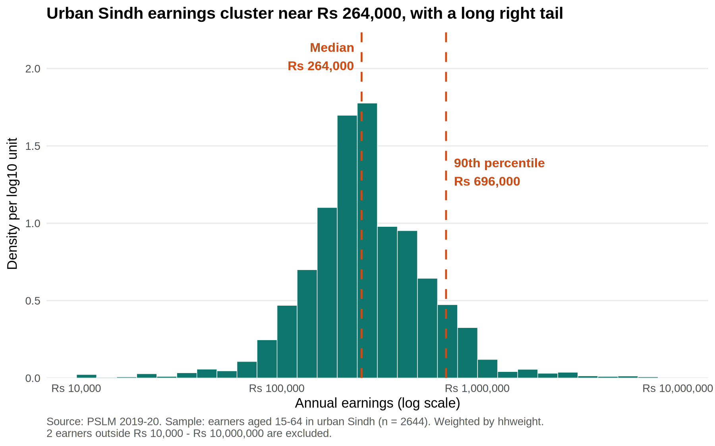
Urban Sindh earnings cluster near Rs 264,000, with a long right tail
Statistic | Rs
Weighted median | 264,000
Unweighted median | 252,000
Weighted P10 | 120,000
Weighted P90 | 696,000
P90 / P10 | 5.80
Weighting raises the median by Rs 12,000, because households carry different survey weights. The unweighted figure would misstate the population.
Source: PSLM 2019–20. Sample: earners aged 15–64. Weighted by hhweight; 2 earners below Rs 10,000 excluded.
Notes:
DISTRIBUTION (about 1 min). Weighted histogram, bins 0.1 wide in log10 units, density per log10 unit. Median Rs 264,000, P90 Rs 696,000. Weighted and unweighted medians differ because the subset over-samples small districts, so hhweight matters.

Slide 3
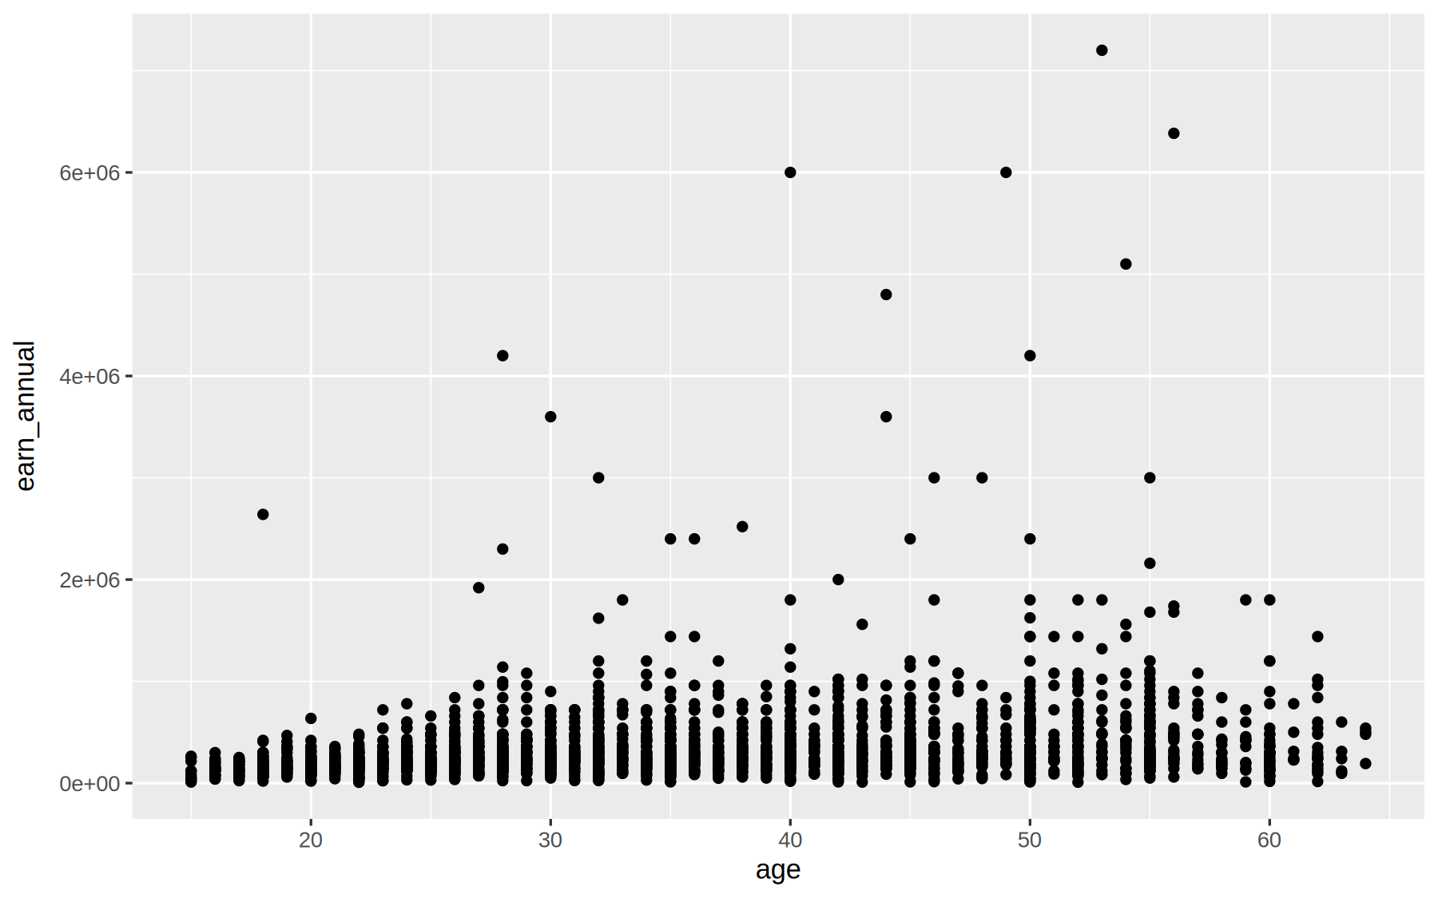
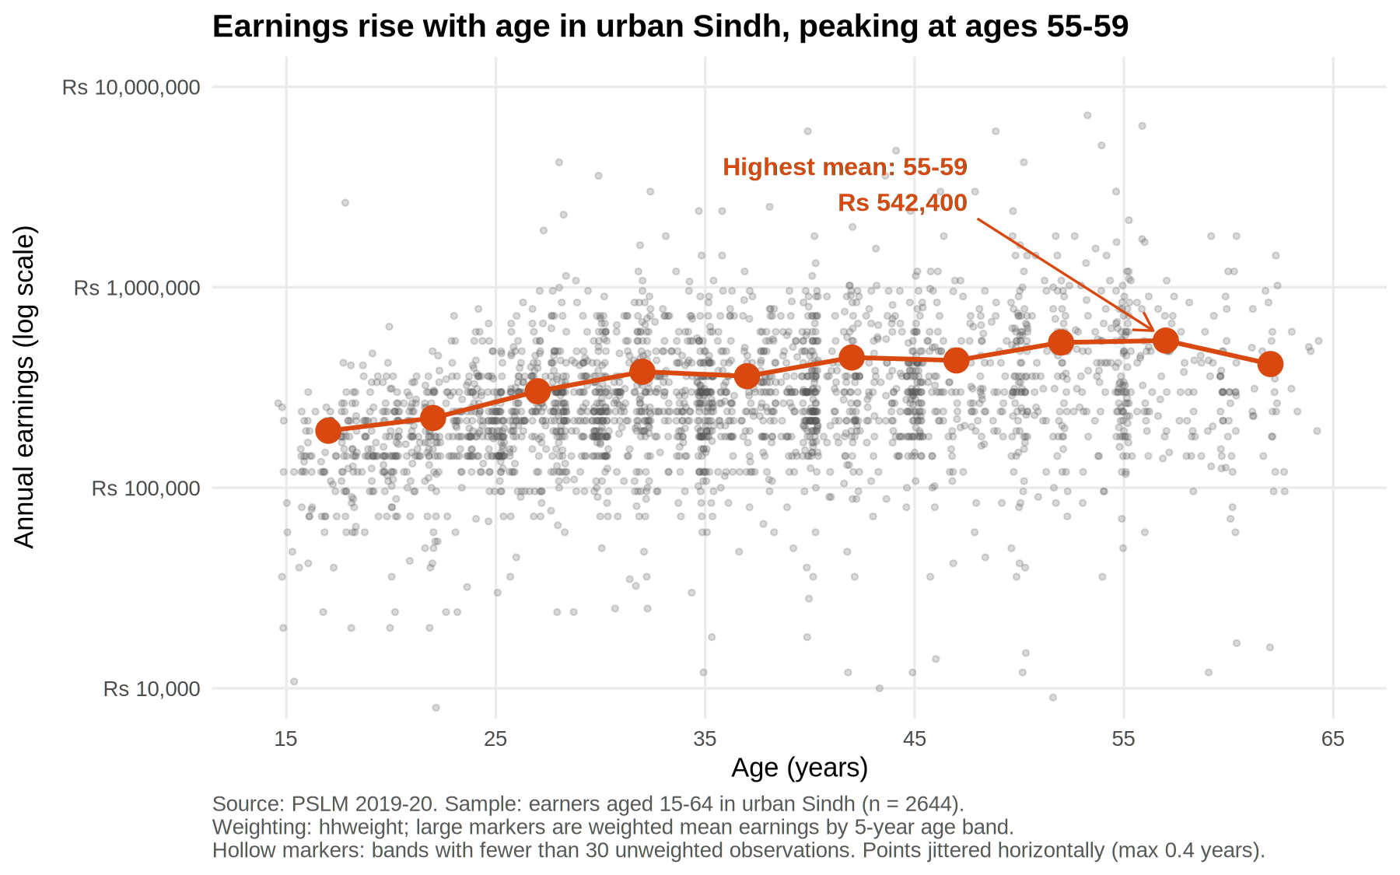
The makeover: from an unreadable cloud to a clear age profile
BEFORE · R default geom_point()
AFTER · redesign
1 Log scale – equal ratios, not rupee gaps
2 Jitter ± 0.4 yr + 22% opacity – fixes overplotting of repeated ages and pay figures
3 Band means + annotated peak – conditional means, not 2,644 dots
Hidden by the redesign: the extreme tail – a few earners at Rs 5–7.2 million, 27× the median, stand out only on the linear axis.
Notes:
MAKEOVER (about 1.5 min). Left: R default, ggplot(data, aes(x,y)) + geom_point(), nothing else, committed first as figures/default.svg. Right: my redesign from Question 3. Change 1, log scale: earnings are skewed and multiplicative, so equal distances should mean equal ratios; the linear default crushes 90% of earners into the bottom strip. Change 2, jitter within 0.4 years and about 22% opacity: ages are whole numbers and pay is reported in round figures, so points stack on top of each other; transparency makes density visible as darkness. Be ready to justify 22%: low enough that overlaps show, high enough that single points stay visible. Change 3, weighted band means joined by a line plus a direct annotation of the peak: conditional means answer the question, the cloud does not. Chapters: perceptual ranking of channels (position over area/colour), data-ink, log scale, overplotting, conditional means. One thing the default shows that the redesign hides: the extreme tail. Largest earner is Rs 7.2 million, 22 earners are above Rs 2 million; on the log axis they look like a small step above the cloud. Both images come from the R scripts in the repository (figures/default.svg and figures/relationship.svg).

Slide 4
Earnings climb with age and peak at Rs 542,400 for ages 55⁠–⁠59
Band | n | Mean (Rs)
15–19 | 160 | 192,523
20–24 | 296 | 222,948
25–29 | 398 | 303,154
30–34 | 396 | 379,254
35–39 | 359 | 360,221
40–44 | 344 | 446,533
45–49 | 250 | 431,697
50–54 | 212 | 530,773
55–59 | 157 | 542,400
60–64 | 72 | 414,262
55–59 earns 2.8× the 15–19 band; 60–64 falls to Rs 414,262 (n = 72). No band is thin (all n ≥ 30).
Cannot tell us: whether one worker’s pay rises with age – this compares different people in one year (cohorts, selection into work).
Second-language check (Python): 25–29 mean Rs 303,154 · 45–49 mean Rs 431,697.
Notes:
FINDING (about 1.5 min). Most important finding: the cross-sectional age profile rises from Rs 192,523 (15-19) to Rs 542,400 (55-59), a 2.8x gap, then falls in 60-64. No band is thin (smallest n = 72). Caveat: cross-section, so cohort effects and selection into work at older ages mean it is not the return to experience for one worker. Second language: I recomputed the band table in Python; 25-29 mean Rs 303,154 and 45-49 mean Rs 431,697. State your R values next to these; they must agree to the rupee. Default that differed between R and Python: weighted quantile definition (R quantile() and numpy use interpolation; I used smallest x where cumulative weight share reaches p), and also jitter/age-band edges (right-open bands [15,20)). Close: ask for questions.

